Slide 1
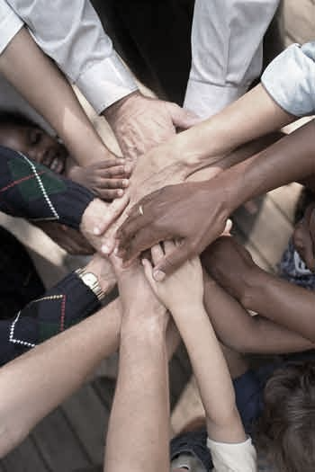
Concepts Citizens Should Know
By: Akea Payton

Slide 2
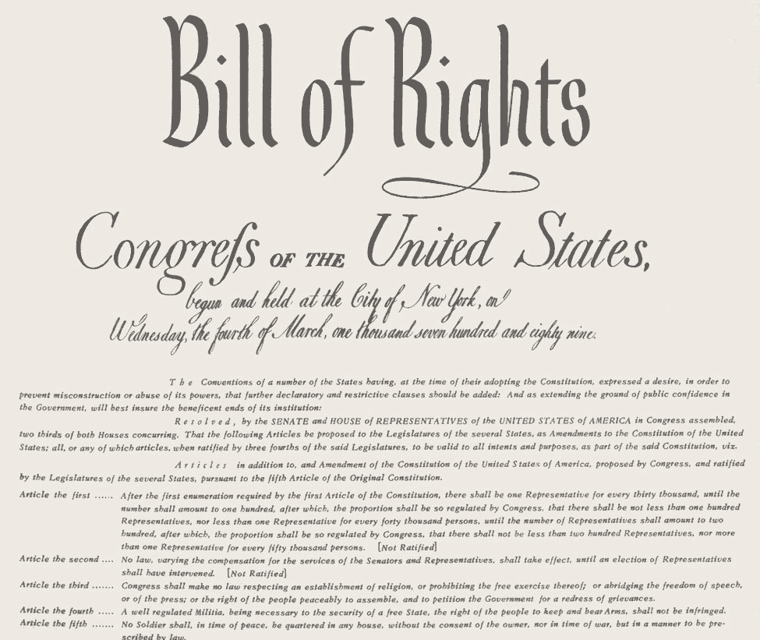
The Bill of Rights
It defines the Rights and Freedom of Americans
Created to protects Americans Rights and Freedoms
“The Bill of Rights was added to the Constitution because the people believed that the rights was too important to not be noticed.
Bill of Rights became a model used around the world to protect human freedom and rights.

Slide 3
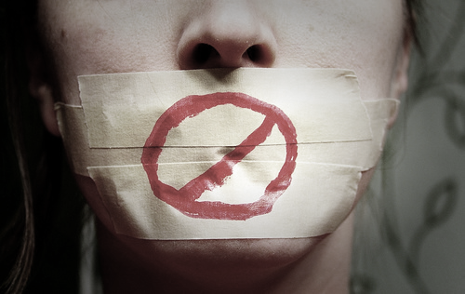
Freedom of Speech
“Congress shall make no laws…abridging limiting) the freedom of speech” (this statement protects the right to express ideas and opinions openly)
Free Speech allows us to criticize our government and government officials.

Slide 4
Right to Vote
The Voting Rights Act protects every American against racial discrimination in voting.
Over the years Six Constitutional Amendments expanded voting rights for Americans. African Americans, Women, and Young Citizen.
Four Federal laws enforced by the U.S. Department of Justice ensure that ALL Americans are allowed to register and vote.
Men: state allowed them to vote regardless of property ownership.
Young Americans: Citizens 18 years or older can vote in federal, state, and local elections.
African Americans: Fifteenth Amendment provided voting rights for them. “Color or Race cannot be denied to vote”

Slide 5
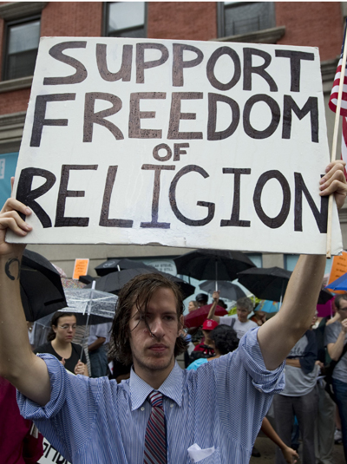
Freedom of Religion
“Congress shall make no law… respecting an established of Religion”
The First Amendment prevented the government from establishing an official religion or from limiting the freedom of Religion
U.S Supreme Court interpreted and required a Separation of Churches and States. Clearly divided between government and religions)

Slide 6
Federalism
Federalism: Balance of power between state and federal government.
Federalism is a System of government a written constitution which divides power between governments.
Expressed by the United States Constitution.
Delegate Powers: Federal Government
Reserved Powers: State Government

Slide 7
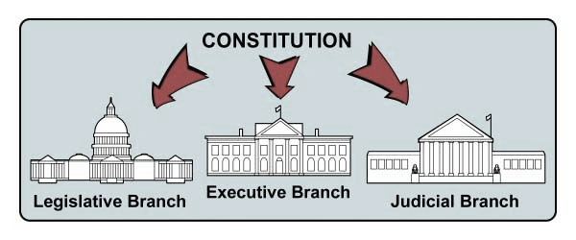
Separation of Powers
The division of government responsibilities to prevent another branch from over powering another.
Baron de Montesquieu separated the Branches
Legislative Branch- Writes Law (President)
Executive Branch- Enforces Laws (Senate and House of Representatives)
Judicial Branch- Judge Laws and interpret constitution ( Supreme Court and Lower Courts)

Slide 8
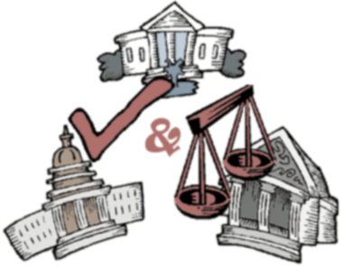
Checks and Balances
Each three branches of the government limit the powers of the others, no one branch can become too powerful.
Make sure the powers are balanced among each Branch.
The branches check and balances each other so that no other branch become more powerful.
Each branch can cancel the action of another branch.

Slide 9
Liberal and Conservative
Liberal believes in government actions to achieve equal opportunity
Conservative believes in personal responsibilities, limited government and individuals liberty.
Liberal= Lots of Government in Economy
Conservative= No Government in Economy
Liberal ; government protect, help, take care of people
Conservative; government provide opportunity, the people take care of themselves.
Liberal; High Spending, High Taxes
Conservative; Less Spending, Less taxes

Slide 10
Issues | Liberal | Conservative
Abortion | the government should provide funded abortion for women | Abortion is the murder of a human being.
Death Penalty | Imprisonment is the appropriate punishment for murder. | Executing a murderer is the appropriate punishment for taking a life.
Economy | Government regulation in all areas of the economy is needed. | Free market produce more economic growth, more jobs and higher standard of living.
Education & School Vouchers | Vouchers take away money from public schools. Government should include additional funds, raising teachers salaries and reduce class sizes. | Vouchers create competition which encourage schools to improve performances. Vouchers gibe parents the right to choose a good school for their children.
Energy | The government must produce a plan for all energy resources. | Increased domestic production creates lower prices and less dependence.
Health Care | Every American has the right to affordable health care. The government should provide equal health care benefits for all. | All Americans has access to health care. Uninsured individuals problems should be addressed within the free market healthcare system- the government should not control health care.
Private Property | Government has the right to use eminent domain. | Respect ownership and private property rights.
Taxes | Higher taxes larger government. Taxes enable the government to provide welfare and create jobs. | Lower taxes and smaller government with limited powers will improve the standard of living.
Welfare | Welfare is a device to protect the poor and provide their needs. | Oppose long-term welfare. Provide to make opportunities to those in need.

